Slide 1
Simulating Quantum Computation in TypeScript

Slide 2
(Photo Credit : Wikimedia Commons)

Slide 4
Some quantum mechanics concepts…

Slide 5
Superposition
(Photo Credit : Wikimedia Commons)

Slide 6
Superposition
A quantum system can be in all the allowed possible states simultaneously, until it is observed.
On observation, it collapses to one of allowed states, according to a probability.
(Or the universe splits into as many allowed number of states. You will see the result corresponding to the version of the universe you are in.)

Slide 7
Superposition
Read about:
Double slit experiment
Quantum Eraser experiment

Slide 8
Entanglement
Spooky action at a distance.
- Albert Einstein

Slide 9
Entanglement
When quantum particles are entangled, their states are no longer independent, such that any effect on the state of one of the particle, has immediate effect on the other, no matter how long they are separated spatially.

Slide 10
Entanglement
Read about:
Aspect’s experiment

Slide 11
Decoherence
It’s an effect that destroys the coherence in the probabilistic nature of a quantum system.
It can be caused by the interaction of a quantum particles with the surrounding particles.
It can also be caused due to external noise and also due to energy dissipated due to irreversible functions on bits, which plays an important role in Quantum Computing.

Slide 12
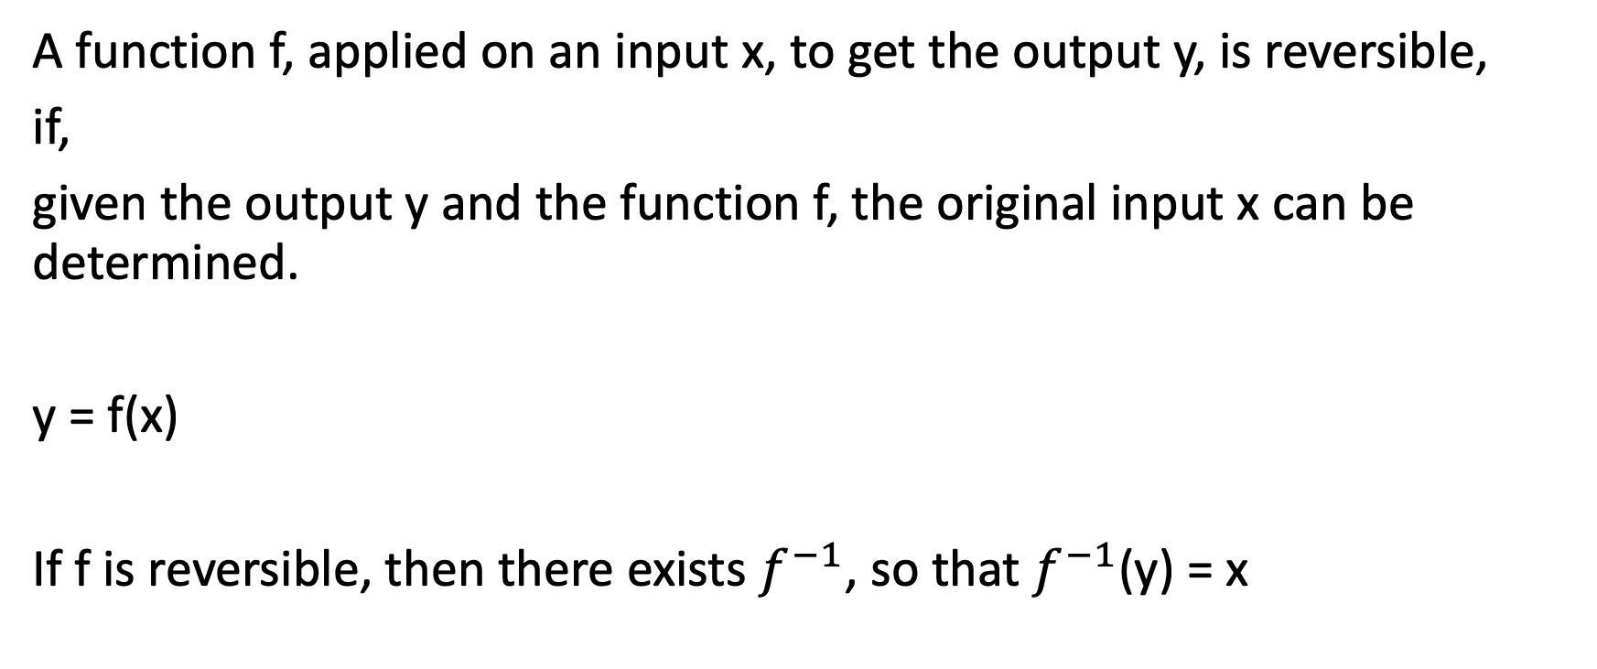
Reversible function
A function f, applied on an input x, to get the output y, is reversible,
if,
given the output y and the function f, the original input x can be determined.
y = f(x)
If f is reversible, then there exists $f^{−1}$, so that $f^{−1}$(y) = x

Slide 13
Reversible function
A bit operator, NOT, is reversible
NOT(0) = 1 and NOT(1) = 0
AND operation is not reversible
AND(0, 0) = 0 AND(1, 0) = 0 Given the output 0 and the operation AND, one cannot determine if the input was (0,0) or (1,0)

Slide 14
Landauer’s principle
Rolf Landauer’s of IBM, showed that if there is a fundamental limit beyond which energy efficiency of computers using irreversible bit operation cannot be increased.
The information loss in the irreversible bit operations is dissipated as waster energy.
This dissipated energy can cause decoherence in quantum computers.
Therefore, all quantum logic gates have to be reversible.

Slide 15
Brush-up on matrices
Matrix multiplication
a b e f a*e + b*g a*f + b*h
c d g h c*e + d*g c*f + d*h
a
c
e
g
a*e + c*f
a*g + c*h
b
d
f
h
b*e + d*f
b*e + d*f
a
c
e
a*e + c*f
b
d
f
b*e + d*f
a
a*c
a*d
c
d
b
b*c
b*d

Slide 16
Vector product
c
a*c
a
a
c
d
a*d
d
b*c
b
c
b
d
b*d

Slide 17
Qubit
Quantum Bit
It has two base states 0 and 1, just like a classical bit.
But I can also exist in infinite states between 0 and 1, before measurement, unlike a classical bit.
But once its observed it will collapse into either 0 or 1 according to some probability.

Slide 18
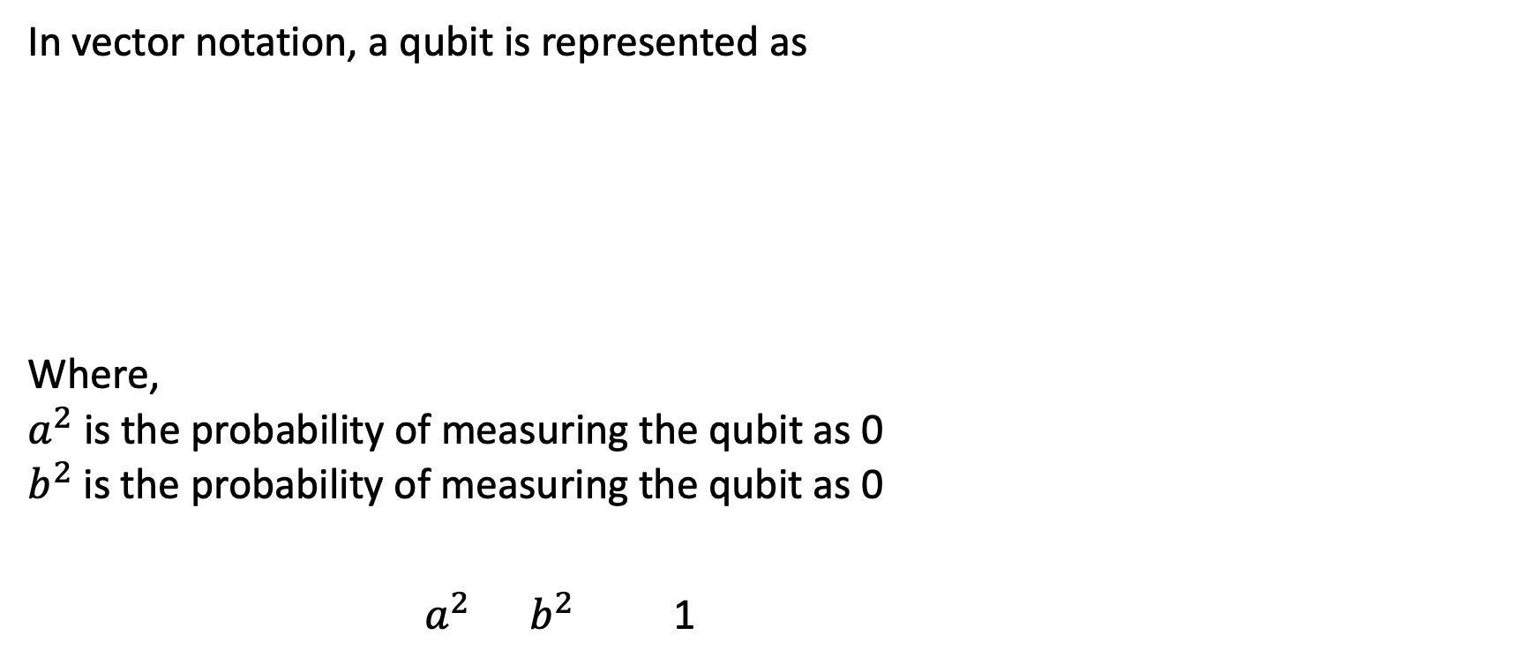
Qubit
In vector notation, a qubit is represented as
Where,
$a^{2}$ is the probability of measuring the qubit as 0
$b^{2}$ is the probability of measuring the qubit as 0
$a^{2}$ $b^{2}$ 1
a
b

Slide 19
Qubit
A qubit can be a photon where horizontal polarization of the photon can be considered as a 0 state and a vertical polarization can be 1.
Or it can also be an electron, where spin up is 1 and spin down is 0.
IBM-Q, uses a superconducting inductor, kept at -273.135 Celsius called
Transmon qubit.

Slide 20
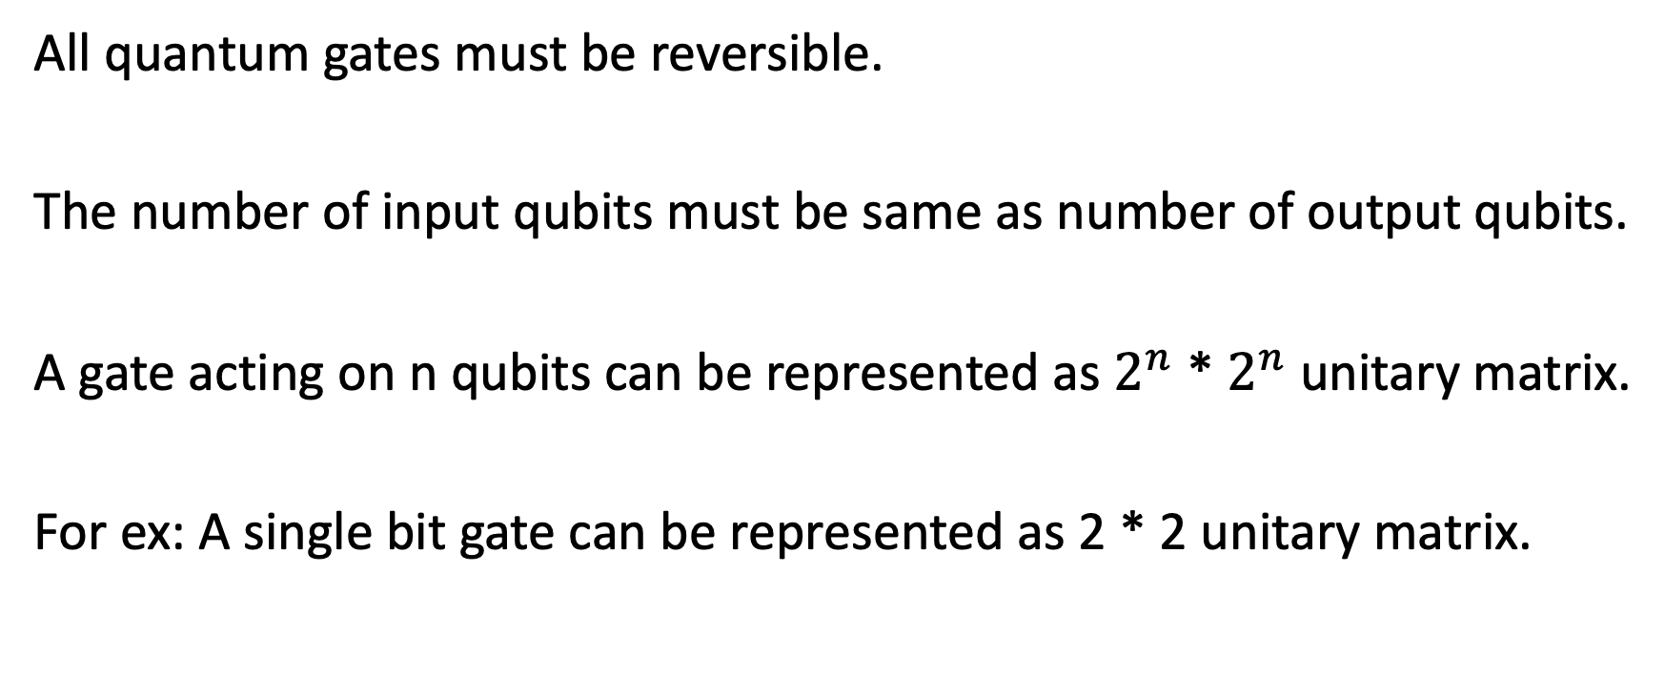
Quantum Gates
All quantum gates must be reversible.
The number of input qubits must be same as number of output qubits.
A gate acting on n qubits can be represented as $2^{n}$ * $2^{n}$ unitary matrix.
For ex: A single bit gate can be represented as 2 * 2 unitary matrix.

Slide 21
NOT gate
Matrix notation:
Ex: Not(0) = 1
0
1
1
0
Reversible NOT(1) = 0
0
1
1
0
0
1
0
1
1
0
0
1
1
0
1
0

Slide 22
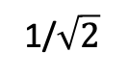
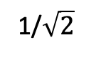
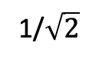
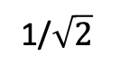
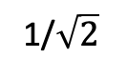
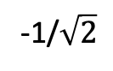
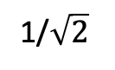
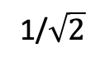
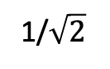
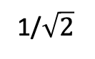
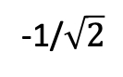
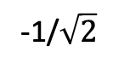
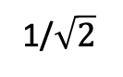
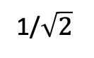
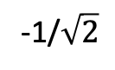
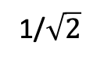
Hadamard Gate
Hadamard(0)
1/$\sqrt{2}$
1/$\sqrt{2}$
1
1/$\sqrt{2}$
Puts a base qubit to uniform superstition
Matrix notation
1/$\sqrt{2}$
-1/$\sqrt{2}$
0
1/$\sqrt{2}$
Hadamard(1)
1/$\sqrt{2}$
1/$\sqrt{2}$
1/$\sqrt{2}$
1/$\sqrt{2}$
1/$\sqrt{2}$
0
1/$\sqrt{2}$
-1/$\sqrt{2}$
1/$\sqrt{2}$
-1/$\sqrt{2}$
1
-1/$\sqrt{2}$

Slide 23
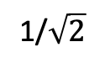
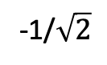
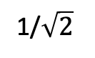
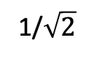
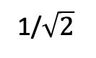
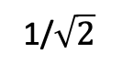
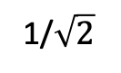
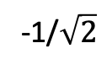
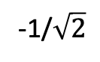
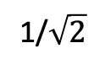
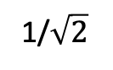
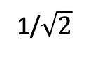
Hadamard Gate
Hadamard gate is reversible. Applying Hadamard gate on a superposed qubit gives back the base state
1/$\sqrt{2}$
1/$\sqrt{2}$
1/$\sqrt{2}$
1
1/$\sqrt{2}$
1/$\sqrt{2}$
1/$\sqrt{2}$
0
1/$\sqrt{2}$
-1/$\sqrt{2}$
0
1/$\sqrt{2}$
-1/$\sqrt{2}$
1
1/$\sqrt{2}$
-1/$\sqrt{2}$

Slide 24
CNOT
Controlled Not. It operates on 2 qubits
Cin
input
output
Matrix notation:
0
0
0
1
0
0
0
0
1
1
0
1
0
0
0
0
0
1
1
0
1
0
1
0
0
1
1
0

Slide 25
CNOT
1
CNOT on two qubits in base state
CNOT(1, 0)
CNOT CNOT
0
1
0
0
0
0
0
0
0
0
1
0
0
0
0
0
1
0
1
1
0
1
1
1
0
0
0
0
1
0
0
0
1
0
0
1

Slide 26
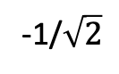
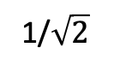
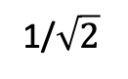
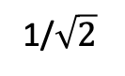
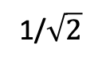
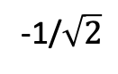
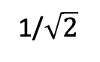
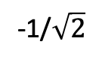
CNOT
1
CNOT on two superposed qubits
CNOT(superposed 0, superposed 1)
CNOT CNOT
1/2
1
0
0
0
1/2
1/2
1/$\sqrt{2}$
1/$\sqrt{2}$
-1/2
-1/2
-1/2
0
1
0
0
1/2
0
0
0
1
1/2
-1/2
1/$\sqrt{2}$
-1/$\sqrt{2}$
1/2
-1/2
0
0
1
0
-1/2
1/$\sqrt{2}$
1/$\sqrt{2}$
-1/$\sqrt{2}$
-1/$\sqrt{2}$

Slide 27
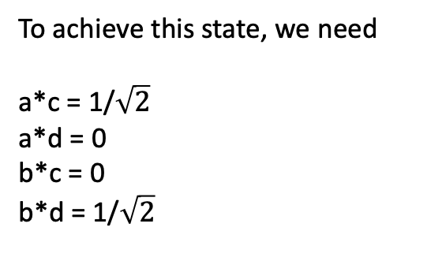
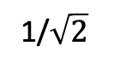
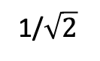
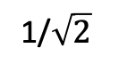
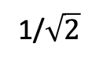
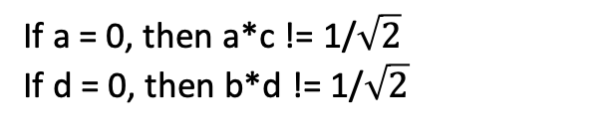
Entanglement with CNOT
CNOT on a superposed qubit and a qubit in base state causes entanglement
CNOT
1/$\sqrt{2}$
1/$\sqrt{2}$
1
0
0
0
a
c
1/$\sqrt{2}$
1
0
0
0
1
0
0
1/$\sqrt{2}$
0
0
0
0
1
b
d
1/$\sqrt{2}$
0
1/$\sqrt{2}$
0
0
1
0
0
To achieve this state, we need
a*c = 1/$\sqrt{2}$
a*d = 0
b*c = 0
b*d = 1/$\sqrt{2}$
If a = 0, then a*c != 1/$\sqrt{2}$ If d = 0, then b*d != 1/$\sqrt{2}$
Hence, there is no two independent states for the qubits to be in.
There are in entanglement, with 50% chance of being 00 and 11.

Slide 28
Deutsch-Jozsa
4 single bit operation
Identity
Negation
Constant 0
Constant 1
Variable functions
constant functions

Slide 29
Quantum Algorithms

Slide 30
Deutsch-Jozsa
Black box
Input
Output

Slide 31
Deutsch-Jozsa
Quantum Deutsch-Jozsa Circuit
Black box
0
X
H
H
X
Output
X
H
H
X
Input
Input Unchanged

Slide 32
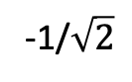
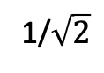
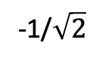
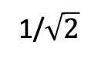
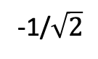



Deutsch-Jozsa
0
-1/$\sqrt{2}$
1
1/$\sqrt{2}$
1/$\sqrt{2}$
1/$\sqrt{2}$
Black box is constant 0
-1
1
0
0
Output
0
X
H
H
X
-1/$\sqrt{2}$
1/$\sqrt{2}$
-1/$\sqrt{2}$
0
-1/$\sqrt{2}$
X
H
H
X
-1
Input
(0)
Input Unchanged

Slide 33
Deutsch-Jozsa
0
-1/$\sqrt{2}$
1
1/$\sqrt{2}$
1/$\sqrt{2}$
1/$\sqrt{2}$
Black box is constant 1
-1
1
0
0
Output
0
X
H
X
H
X
-1/$\sqrt{2}$
1/$\sqrt{2}$
-1/$\sqrt{2}$
0
-1/$\sqrt{2}$
X
H
H
X
-1
Input
(0)
Input Unchanged

Slide 34
Deutsch-Jozsa
0
-1/$\sqrt{2}$
1
1/$\sqrt{2}$
1/$\sqrt{2}$
1/$\sqrt{2}$
Black box is Inverse
-1
1
0
0
Output
0
X
H
H
X
-1/$\sqrt{2}$
1/$\sqrt{2}$
-1/$\sqrt{2}$
0
-1/$\sqrt{2}$
X
H
H
X
-1
Input
(0)
Input Unchanged

Slide 35
Deutsch-Jozsa
0
-1/$\sqrt{2}$
1
1/$\sqrt{2}$
1/$\sqrt{2}$
1/$\sqrt{2}$
Black box is Identity
-1
1
0
0
Output
0
X
H
X
H
X
-1/$\sqrt{2}$
1/$\sqrt{2}$
-1/$\sqrt{2}$
0
-1/$\sqrt{2}$
X
H
H
X
-1
Input
(0)
Input Unchanged

Slide 36
Grover’s Search
Imagine a function
f(x) = 1 | x = a
= 0 | x != a
Lets say, you have N elements, in no order. One of them is ‘a’
The task is to find that element “a” that returns “1” with f(x).
Classically, it takes N attempts (worst case) to find the correct element. It’s a O(N) problem.

Slide 37








Grover’s Search
Grover’s algorithm reduces it to $\sqrt{N}$
It needs log2(N) qubits.
Steps:
1. Superpose all qubits
1/$2\sqrt{2}$
1/$2\sqrt{2}$
1/$2\sqrt{2}$
1/$2\sqrt{2}$
1/$2\sqrt{2}$
1/$2\sqrt{2}$
1/$2\sqrt{2}$
1/$2\sqrt{2}$

Slide 38








Grover’s Search
2. Pass all superposed qubits to an oracle function. The Oracle should invert the probability of correct state
1/2$\sqrt{2}$
1/2$\sqrt{2}$
1/2$\sqrt{2}$
1/2$\sqrt{2}$
1/2$\sqrt{2}$
1/2$\sqrt{2}$
1/2$\sqrt{2}$
1/2$\sqrt{2}$

Slide 39









Grover’s Search
3. Invert all probabilities over average(Grover’s Diffuser).
This will increase the probability of desired state and reduce others.
Repeat this $\sqrt{N}$ times, to get the probability of desired state close to 1
1/4$\sqrt{2}$
1/4$\sqrt{2}$
1/4$\sqrt{2}$
1/4$\sqrt{2}$
5/4$\sqrt{2}$
1/4$\sqrt{2}$
1/4$\sqrt{2}$
1/4$\sqrt{2}$

Slide 40
Grover’s Search

